Slide 1
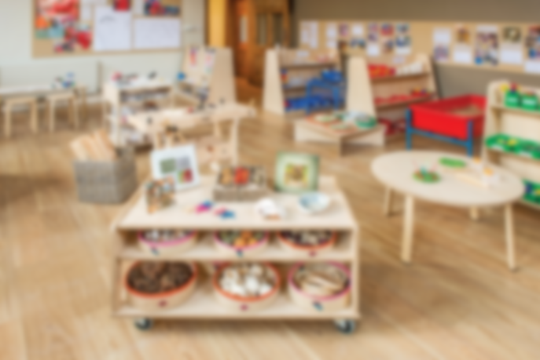
EYFS
Curriculum
New Framework
2022-2023
Withington Primary School

Slide 2
Our Vision
At Withington Primary School, we educate our children for life within a happy, safe and caring environment which values the diverse backgrounds of all pupils and families. We provide the children with the opportunities to become confident communicators who are able to work independently or supportively with others and we are committed to encouraging everyone to reach their own highest potential within a culture of respect and care.
In the EYFS specifically, we provide a high-quality education giving children a secure and confident start to their school life. We are committed to nurturing a lifelong love of learning alongside the aims of the EYFS Statutory Framework. We strive for high standards, consider the development of the whole child and seek to foster resilience and independence. We are inclusive and welcoming to all and we aim to provide the essential knowledge that children need to prepare them for their future success. We endeavour to give children the best possible to start to their early education. To do this we plan our curriculum so that it can:
Broaden minds and children’s outlook on life
Provide experience of awe and wonder
Reduce disadvantage
Consider children’s backgrounds and experiences
Develop knowledge and understanding of the community and wider world.

Slide 3
Our Classes
Staffing and Organisation
At Withington Primary School we have one Foundation class. The classroom has a variety of free choice provision and areas for the children to access. The class has a full time teacher, a Nursery Nurse and a TA (Level 1).
All of the children in the Early Years have access to a large outdoor area which reflects the practice.
Staff are organised to support the children in a balance of adult-led and child-initiated experiences throughout the session.
The experienced team plan a variety of exciting leaning opportunities each day as well as responding to unplanned themes or topics that interest the children.

Slide 4
Play, scaffolding, modelling & directed teaching
How do we teach children in the EYFS?
In the classroom, you may see children playing alone or with their peers, deciding on resources and choosing how to spend their time. You may see a child playing with and listening to an adult, who is modelling how to achieve something or teaching a new skill hat interests the child.
Adults may scaffold a child’s play. This involves taking their play to higher levels of learning, entering the play as a co-creator and helping to provoke a framework for the children to go from ‘what they know’ to ‘what else could they know?’. Scaffolding enables a child to solve a problem, carry out a task or achieve a goal which is beyond his or her abilities. During play, where foundational social and emotional skills are developed, scaffolding is a bridge to new skills levels using three key ingredients; modelling the skill, giving clues and asking questions while the child is trying out a new skill, and as the children approaches mastery, withdrawing the support.
The new statutory framework does not prescribe a particular teaching approach. The DfE (2021) state that “Play is essential for children’s development, building their confidence as they learn to explore, relate to other, set their own goals and solve problems. Children learn by leading their own play, and by taking part in play which is guided by adults.”
At Withington, the EYFS team decide what we want our children to learn in our classroom, through our provision, and the most effective ways to teach it. Each day, we stimulate children’s interests, respond to each child’s emerging needs and guide their development through warm, positive interactions coupled with secure routines for play and learning. As the children grow older and develop their skills throughout the Reception year, we use more direct teaching and modelling and plan specific sequences of lessons. These strategies help us to focus on teaching the essential skills and knowledge in specific areas of learning so that children develop the skills and confidence required for the end of their Reception year.

Slide 5
The Statutory EYFS Framework
The Early Learning Goals (ELGs) are the knowledge, skills and understanding which young children should have acquired by the time they reach the age of five.
There are three prime areas of learning:
Communication and Language Development
Personal, Social and Emotional Development
Physical Development
There are four core areas of learning:
Literacy
Maths
Understanding the World
Expressive Arts and Design
Personal
Social
Emotional
Communication
Language
Physical
Understanding the World
Expressive Art and Design
Literacy
Maths
In addition, the ‘Characteristics of Effective Learning’ underpin learning and development across all areas and support the child to remain an effective and motivated learner.
The Characteristics of Effective Learner are:
Engagement – Playing and exploring
Motivation – Active learning
Thinking – Creating and thinking critically

Slide 6
Planning in the EYFS
Our planning follows the children’s needs and stages of development. We seek opportunities to make links between the areas of learning and plan next steps accordingly.
Our classes loosely follow topics and themes from the Cornerstones Curriculum which we find embeds the EYFS curriculum in an exciting and age-appropriate way whilst giving EYFS children a taste of some foundation subjects.
We deliver the curriculum through planned, purposeful play as well as adult-directed learning to enable the children to build on what they already know, in class the children are taught in whole class, small groups or individuals to ensure that all children are making progress from their own individual starting point.
We provide a challenging, exciting and attractive learning environment that offers high-quality opportunities for the children to lean through play within the classroom and outside. Our classes have continuous provision that are designed to offer practical, open-ended learning opportunities where children are enabled to think creatively and imaginatively. The children are supported to explore how resources can be adapted and use their skills in a variety of contexts. We develop problem-solving skills through open-ended tasks and encourage children to share their thinking with others.
We also use parent observations on Class Dojo to learn more about children’s likes and dislikes.

Slide 7
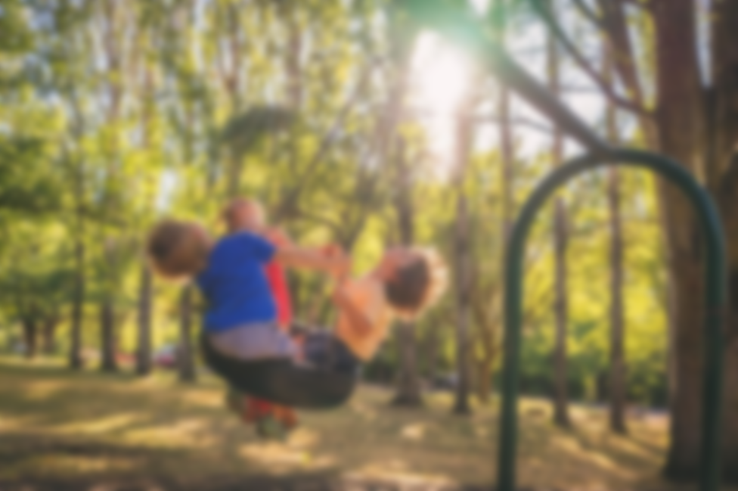
To support children’s skills in the prime area of PSED, we aim to promote an understanding of people, different cultures and communities beyond their own. Through PSHE lessons and learning opportunities we teach the language of feelings to develop emotional literacy and support emotional security through regular circle time sessions, discussions, modelled behaviour and provision of a safe learning environment.
We have weekly focus session on the Metacognition of Effective Learning which supports the children’s independence and builds on key skills that they will need throughout life.
We teach the children about how to keep themselves healthy through good hygiene, healthy eating, exercise and being kind to themselves and others.
Personal Development

Slide 8

Quality fiction and non-fiction texts for focused learning and story time
Adult modelling, questioning and conversation
Carpet time and timetabled sessions for attentive listening
Daily story time
Vocabulary displayed in classroom
Observed interaction between peers
Scaffolded play and conversation with EYFS team
Daily nursery rhymes and songs to develop vocabulary and extend learning (Nursery)
NELI delivered across EYFS
Communication and Language

Slide 9
Daily modelling of school rules
Clear routine
Positive reinforcement of expected behaviour
Circle time and scaffolded social interactions to support friendships
Parental involvement; All About Me, Tapestry
Children choose friendships and are encouraged to play with others
Specific lessons on various aspects of PSE
Celebration assembly
Quality texts to support teaching
Observations of children’s interactions and social skills
Calm space available for all chidlren
Personal, social and emotional

Slide 10

Daily access to outdoor and indoor provision which includes:
Own EYFS outdoor provision accessible all year round
Playground, field etc.
Balance beams, trim trail, bridge, tyres
Large plastic building materials
Prams, scooters and pedal toys
Boxes, hoops, tunnels, dens
Sand pit / water toys
Drainpipes and buckets
Mud kitchen
Weekly PE sessions
Appropriate chairs and tables for EYFS children
Gross motor development

Slide 11
Handwriting formation included in phonics sessions (Reception)
Songs and rhymes to support formation of letters and numerals
Provision of left and right-handed scissors/modelled support to make snips, cut in line and around a shape
Provision of chunky pencils and crayons
Slimmer writing tolls available for progression
Use of sensory resources for mark making in a variety of ways such as shaving foam, playdough, paint etc.
Fine motor activities planned into provision
Support for using knife and fork at lunch (Reception)
See Pencil grip progression
Fine motor development

Slide 12
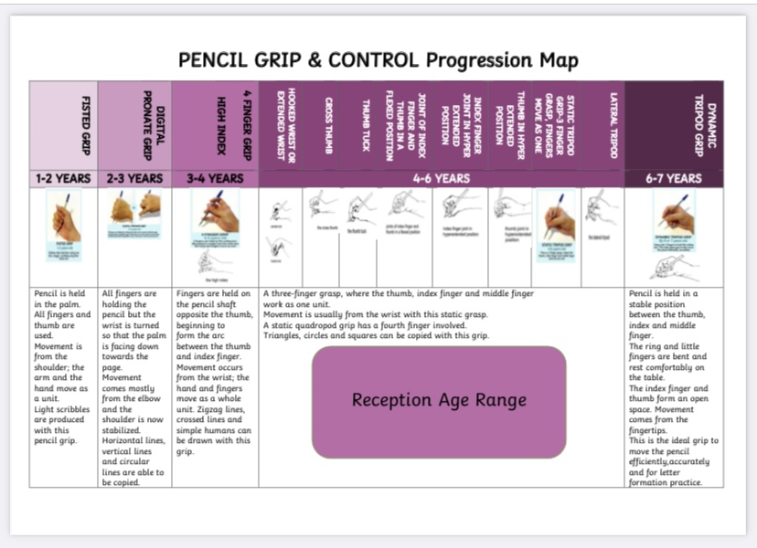

Slide 13
Teaching of Phonics
We use Bug Club

Slide 14
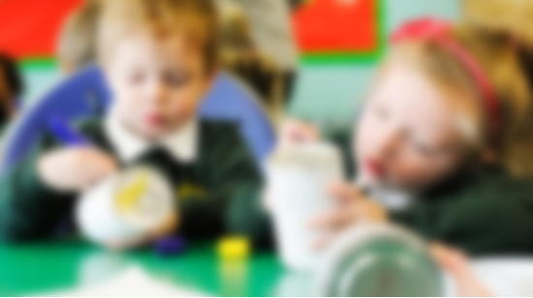
All writing stages are valued and children’s progress is recorded. Children are supported with their gross motor skills. Alongside fine motor activities we provide:
A variety of writing tools in the provision
White boards, chalk boards and a variety of paper inside and outside
Sound mats, literacy displays
Tricky word mats (Reception)
Meaningful reasons and opportunities for the children to write for a purpose
Child accessible writing areas
Songs, repetition and story maps for retelling stories(encourages talking for writing)
Daily shared and modelled writing (In Literacy lesson in Reception and in provision in Nursery/Reception)
Daily support to write their name (Reception)
Literacy - writing

Slide 15
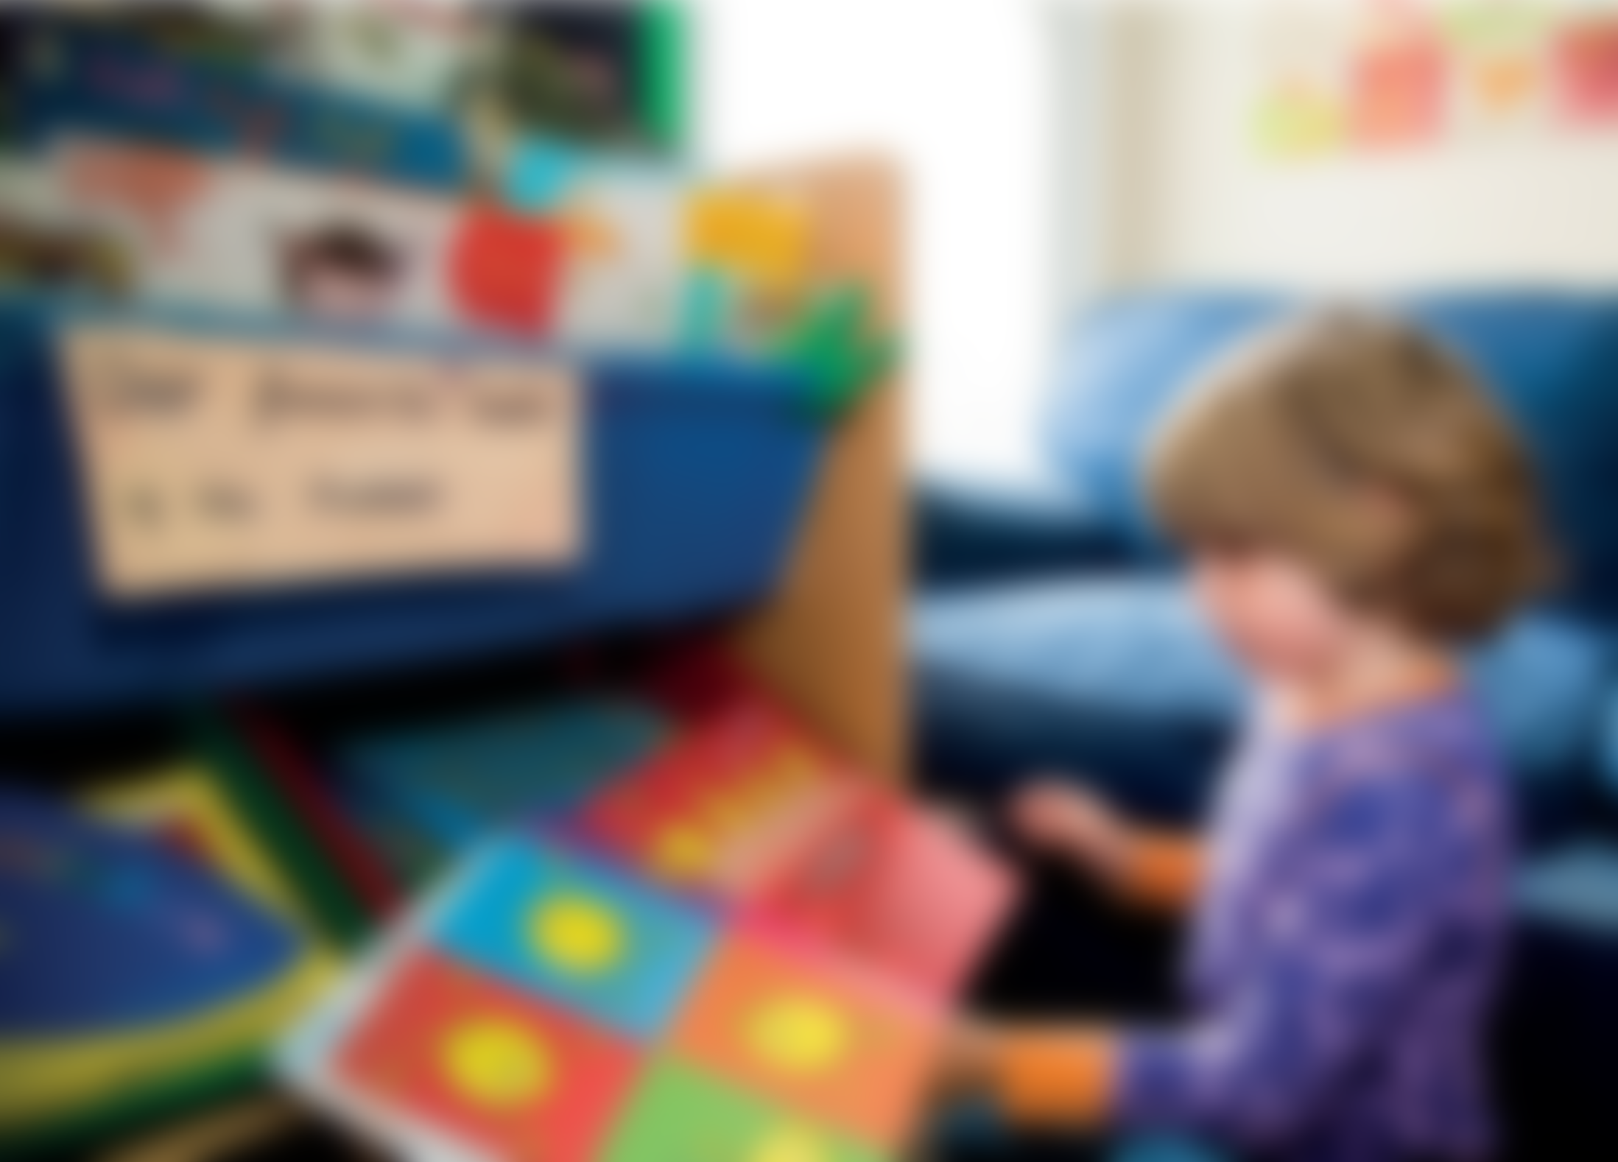
Daily shared and modelled reading in Literacy lessons
Provision of diverse books including traditional and modern
Planned daily phonics
Use of phonic scheme (Bug Club Phonics)
Taught nursery rhymes
A variety of high quality fiction and non-fiction texts in provision
Daily phoneme/grapheme revisit
Meaningful reasons and opportunities for the children to read
Child accessible reading areas and the opportunity to decide what they would like to read
Daily story time
Guided reading sessions
Reading books sent home and progression tracked
Daily opportunities for blending and segmenting
Comprehension observed in provision and in guided reading sessions
Literacy - reading

Slide 16
The following Strategies are used to support the children’s progression in reading:
Teachers to read with children individually every day
Children to be added to Bug Club and new books uploaded regularly
Shared guided reads in Nursery to learn book handling and book basics
Identified children to be given reading books in Nursery and added to Bug Club when appropriate
Literacy - reading

Slide 17

Maths sense and number patterns
Discreet maths teaching, modelled activities and guided learning
Observations of children’s mathematical thinking in the provision
Maths songs, rhymes throughout the day
Mathematical challenges in the provision
Good quality construction/pattern and building sets
Focus on composition of smaller numbers before moving on
Sustained focus on each number (Nursery)
Assessment through observations/questioning
The use of schemes such as White Rose Maths, NCETM and Numberblocks to support planning
Provision of manipulatives and resources such as Numicon, number frames, counters, cubes, abacuses

Slide 18
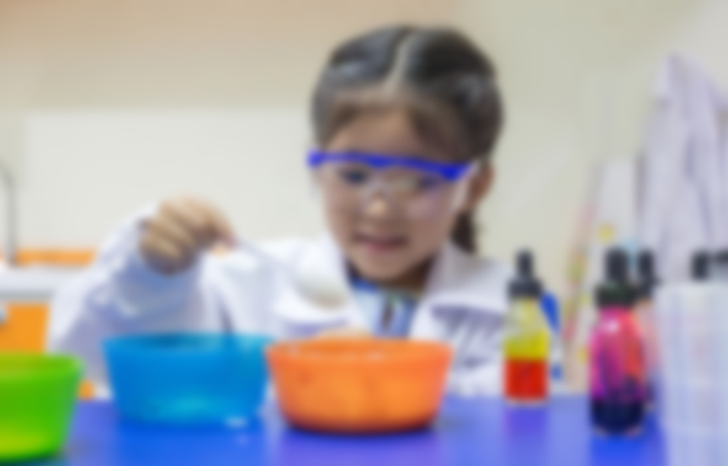
Understanding the World
Planned directed learning as well as learning in the environment
Look at the seasons and how the environment changes and explore the weather – themes
Provide interesting natural environments for the children to explore freely outdoors
Spend time with children talking about photographs and memories
Investigate various occupations (visits)
Show and explain the concepts of growth, change and decay with natural materials
Plan and introduce new vocabulary related to exploration
Investigate various life cycles; chick, butterfly, frog etc.
Read high quality fiction and non-fiction texts
Use Hereford’s Agreed Syllabus planning for discreet RE planning
Explore sinking and floating and light through topics/themes

Slide 19
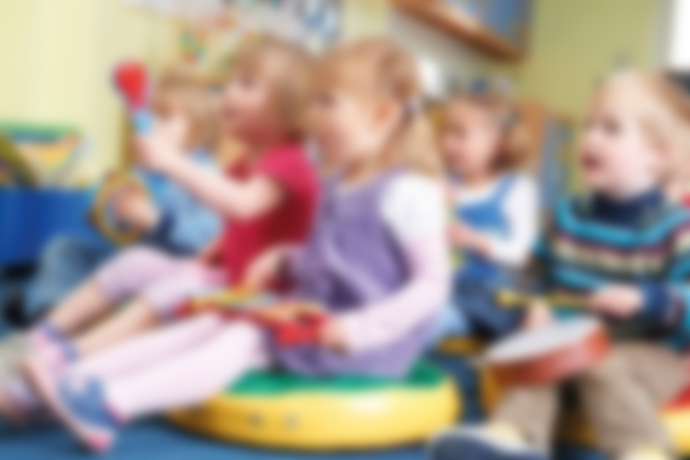
Expressive Art and Design
Teach children to develop their colour-mixing techniques
Provide opportunities to work together to develop and realise creative ideas
Provide children with a range of materials for children to construct with, encourage them to think and discuss what they want to make, discuss problems and how they might be solved.
Introduce children to new music genres and use KAPOW to support music lessons
Provide appropriate costumes and props to support children’s imaginative play
Sing in a group or on their own – use nursery rhymes as well as popular music to encourage involvement
Play movement and listening games
Encourage children to ‘keep the beat’ with a range of music
Encourage children to replicate dances e.g. pop dances as well as choreograph their own simple moves
Take part in performances

Slide 20
Working with Parents
Working in partnership with parents
We value the contribution that our parents and carers make to their child’s learning and take every opportunity to work in collaboration with them. We provide an opportunity for parents to complete and ‘All About Me’ booklet when the children start school and give parents online access to Tapestry where they can add their own observations. In the Autumn and Spring terms we hold parent’s consultations and in the Summer term we send home detailed reports.
The children in Reception take home reading books to share along with a reading record which parents/carers are asked to write in. We provide opportunities over the year for parents to come in and enjoy a special moment with their child; themed days such as Seaside Day and the Fairytale Trail.
We also have Class Dojo for each class to support communication between home and school and we send home WOW certificates for parents to fill in at home.
Community links and the wider world
Over the year, we arrange visits within the community and slightly further afield e.g. local farms and parks.
We use artefacts from other cultures to introduce new concepts in rea-life contexts. We aim to develop the children’s awareness of other cultures by exploring different countries and celebrations through our RE lessons.

Slide 21
Assessment
Observation and Assessment
In the EYFS at Withington Primary School, the team uses a range of strategies to gather information about the children’s learning and development. We use observation as our main form of assessment and ‘WOW’ moments are recorded in a learning journal online called ‘Tapestry’. Tapestry is a secure online journal which builds on children’s experiences during their time with us. It enables parents to view work from school and find out how their child is doing online. Parents can share pictures/videos with school in order to inform some planning and assessment of children. Keeping children safe online is extremely important to us and we therefore ask parents to sign an agreement to show they understand and agree with our guidelines whilst using Tapestry. Parents can also use the class Dojo.
The children’s learning is monitored and sometimes observed through photographs and videos. Literacy and Maths are recorded in books in Reception and put on display in Nursery/Reception. We collect other physical evidence as well which we file in the child’s individual learning journey. Teachers constantly use their professional judgement to decide what a child is achieving and what they need to do next. The staff watch the children interacting through their play and learning and observations are made by teachers and teaching assistants.
During the first few weeks of the Autumn term the class teacher completes a baseline assessment on each child to decide which band they are working within. We record children who are ‘green –expected, amber – emerging, red – in need of significant support. Any necessary referrals are the made.
We reassess this at the end of each term and readjust which areas we need to target next. Tracking progress is what enables staff to monitor the progress the children are making in all areas and check the coverage of all areas of the curriculum. In the summer term, the Reception teachers review the ELGs and decide whether each child is working below or at the expected levels. Judgments against the ELGs are based on observations, evidence in books and discussion with all staff involved with the child.
Red | Amber | Green

